Slide 1




Introducing Excel dynamic array functions

Slide 2
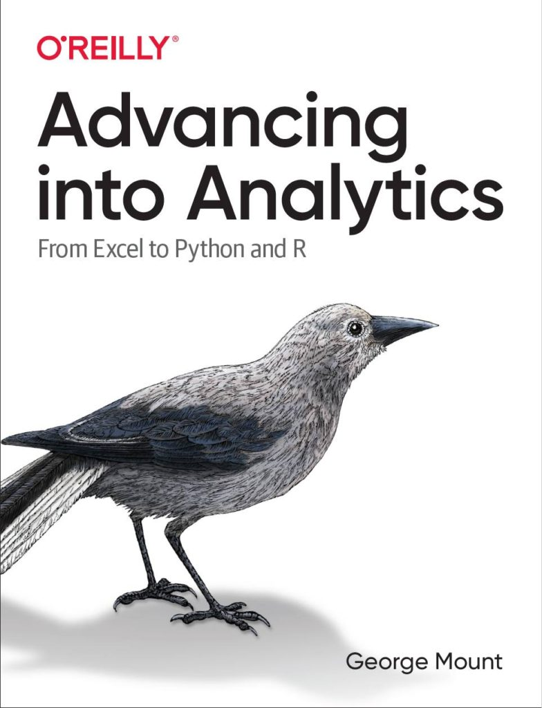



Hi, I’m George

Slide 3

Objectives for this session
Prepare, profile and analyze data in Excel workbooks
Hack PivotTables and PivotCharts for compelling analysis
Discover point-and-click analytics with the Analysis ToolPak

Slide 4
Download the files:
https://swiy.co/FW5w
Feel free to share to latecomers
Downloads & recording will move to Patreon after 48 hrs

Slide 5
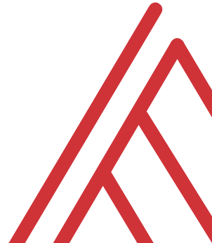
Terms of engagement
Feel free to share the download link with latecomers ☺
Participation is welcome via the chat/unmute
Demos work best with 365 for PC
Recording goes out later today, moves to Patreon after 2 days
I will do my best to answer your questions

Slide 6


What the hey is EDA?
Preliminary understanding of variables
Classify them
Summarize them
Visualize them
Check assumptions before using them
YOU
YOUR DATA
Notes:
What do we mean by EDA? This is the first step of getting to know the data. We just want to see what we are working with and what kind of statistical analysis might be possible from the data.

Slide 7
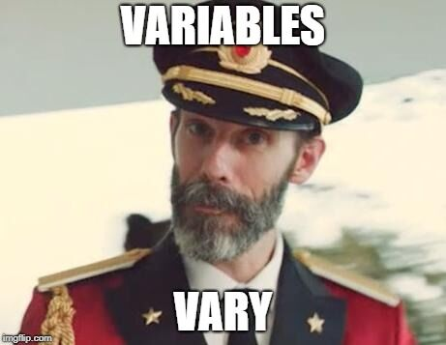
What is a variable?
Classical statistics: at least a 90%/10% split
Notes:
But before we even get into analyzing variables, let’s consider what they even are. It seems like a silly distinction but analyzing variables is what we do as analysts. For classical statistics, a variable needs to have at least a 90%/10% split to be considered a useful variable. This may seem like a trivial point, but consider something like anomaly detection where the event we are interested in may only be a one in a thousand event. This would not be a 90%/10% split, so a lot of classical statistics would have a hard time working on this problem. This is where ML/AI might come in.

Slide 8


VARIABLE TYPES AS RECIPE INGREDIENTS
Notes:
When we get a dataset, we want to see the kinds of variables we have. Think of each variable as like an ingredient. And based on those ingredients we can make different dishes. Like a “Chopped” competition.

Slide 9
WHAT’S ON THE TABLE?
Variable
Categorical
Binary
Nominal
Quantitative
Discrete
Ordinal
Continuous
Notes:
Basic overview of the types of variables:
Broad split b/w categorical and quantitative
First, categorical. For these, there are a fixed number of values that variable can take:
- In the case of binary, it’s two (yes/no, black/white)
- Nominal can have more than two, think of all 50 states, or 7 days of the week
- For ordinal, order matters, consider Freshman/Sophomore/Junior/Senior. However this corresponds to years 1, 2, 3, 4, so these can be numbers too!
Then, quantitative. These are numeric
- With a difference that with discrete, there are only a certain number of values that can be taken, for example, you can’t have 2.5 children, but we often use that as a statistical convenience, so you will see there is some wiggle room here.
- Finally, continuous – this is the one for which there can be any possible value. Height/weight/blood pressure. A lot of things in the natural world. Also money is for all intents & purposes continuous.

Slide 10
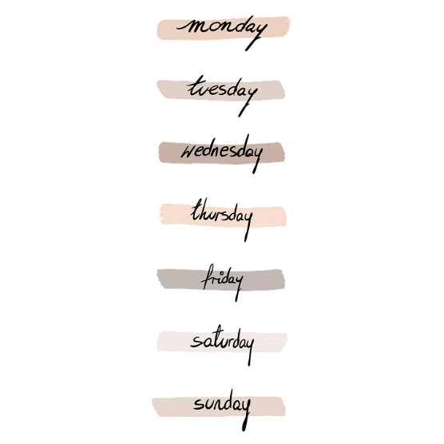


“WHICH KIND?”
Categorical
Binary
Nominal
Ordinal
Notes:
Basic overview of the types of variables:
Broad split b/w categorical and quantitative
First, categorical. For these, there are a fixed number of values that variable can take:
- In the case of binary, it’s two (yes/no, black/white)
- Nominal can have more than two, think of all 50 states, or 7 days of the week
- For ordinal, order matters, consider Freshman/Sophomore/Junior/Senior. However this corresponds to years 1, 2, 3, 4, so these can be numbers too!
Then, quantitative. These are numeric
- With a difference that with discrete, there are only a certain number of values that can be taken, for example, you can’t have 2.5 children, but we often use that as a statistical convenience, so you will see there is some wiggle room here.
- Finally, continuous – this is the one for which there can be any possible value. Height/weight/blood pressure. A lot of things in the natural world. Also money is for all intents & purposes continuous.

Slide 11


“HOW MUCH/HOW MANY?”
Quantitative
Discrete
Continuous
Notes:
Basic overview of the types of variables:
Broad split b/w categorical and quantitative
First, categorical. For these, there are a fixed number of values that variable can take:
- In the case of binary, it’s two (yes/no, black/white)
- Nominal can have more than two, think of all 50 states, or 7 days of the week
- For ordinal, order matters, consider Freshman/Sophomore/Junior/Senior. However this corresponds to years 1, 2, 3, 4, so these can be numbers too!
Then, quantitative. These are numeric
- With a difference that with discrete, there are only a certain number of values that can be taken, for example, you can’t have 2.5 children, but we often use that as a statistical convenience, so you will see there is some wiggle room here.
- Finally, continuous – this is the one for which there can be any possible value. Height/weight/blood pressure. A lot of things in the natural world. Also money is for all intents & purposes continuous.

Slide 12
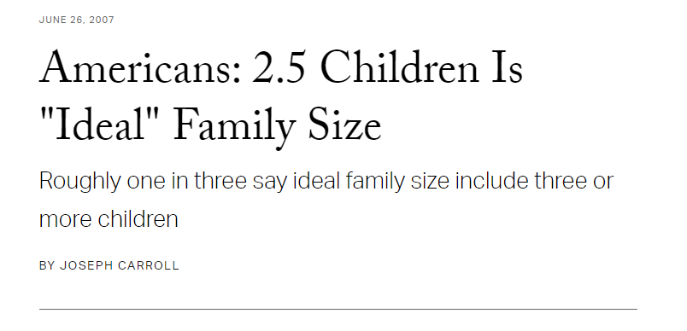
DON’T HOLD ME TO IT…
Treat discrete as continuous (maybe) when:
Large number of observations
Large number of values an observation can take
https://news.gallup.com/poll/27973/americans-25-children-ideal-family-size.aspx
Notes:
Basic overview of the types of variables:
Broad split b/w categorical and quantitative
First, categorical. For these, there are a fixed number of values that variable can take:
- In the case of binary, it’s two (yes/no, black/white)
- Nominal can have more than two, think of all 50 states, or 7 days of the week
- For ordinal, order matters, consider Freshman/Sophomore/Junior/Senior. However this corresponds to years 1, 2, 3, 4, so these can be numbers too!
Then, quantitative. These are numeric
- With a difference that with discrete, there are only a certain number of values that can be taken, for example, you can’t have 2.5 children, but we often use that as a statistical convenience, so you will see there is some wiggle room here.
- Finally, continuous – this is the one for which there can be any possible value. Height/weight/blood pressure. A lot of things in the natural world. Also money is for all intents & purposes continuous.

Slide 13
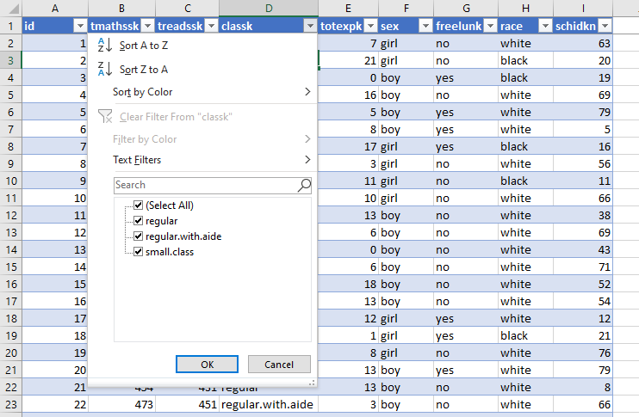
DRILL
File: star.xlsx
What type is each variable?
(Don’t be afraid to poke at the data!)
Variable | Description | Type?
tmathssk | Total math scaled score
treadssk | Total reading scaled score
classk | Type of class
totexpk | Years of total teaching experience
sex | Sex
freelunk | Qualified for free lunch?
race | Race
schidkn | School indicator
Notes:
Check out this dataset of school test scores. Consider what kind of variable you would classify as each. Make your best guess.

Slide 14
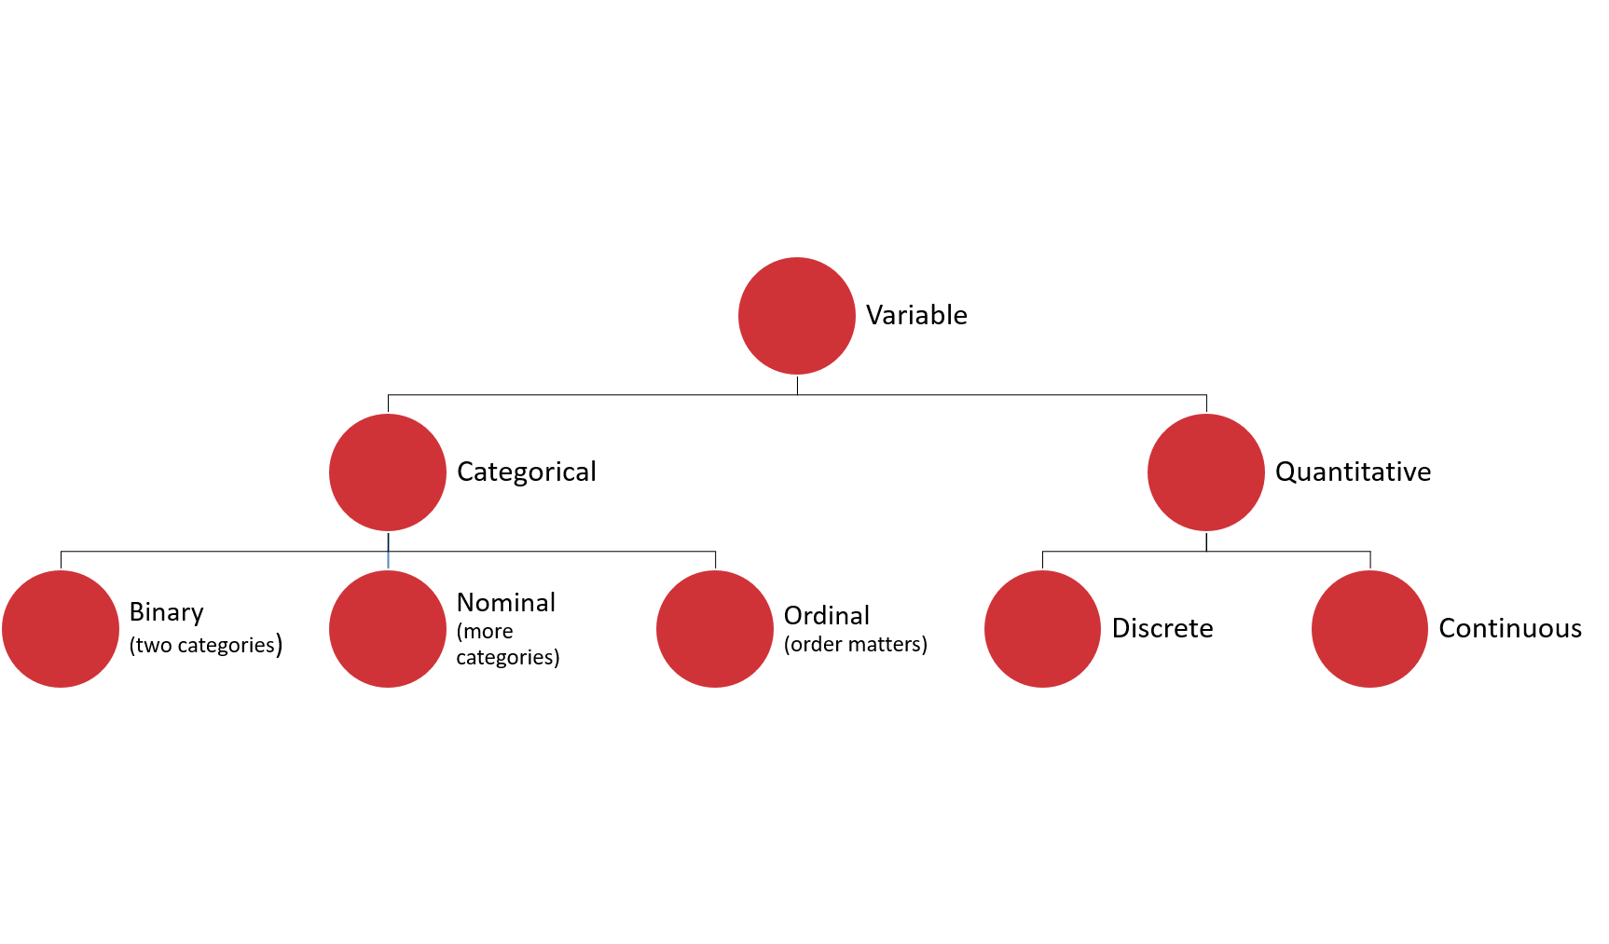
DRILL
File: star.xlsx
What type is each variable?
(Don’t be afraid to poke at the data!)
(Filtering for now…)
Variable | Description | Type?
tmathssk | Total math scaled score | Continuous
treadssk | Total reading scaled score | Continuous
classk | Type of class | Nominal
totexpk | Years of total teaching experience | Discrete
sex | Sex | Binary
freelunk | Qualified for free lunch? | Binary
race | Race | Nominal
schidkn | School indicator | Nominal
Notes:
Here is what I came up with. The first couple are more apparent, but what about things like Years of teaching experience?
That could be an ordinal variable or a discrete variable. It was also difficult to know whether race is binary or nominal, I did it for certain by placing a filter on it to see the distinct values.
Did anyone come up with other classifications and if so would you like to share them?

Slide 15

WHO KNOWS?
VARIABLE TYPES ARE CONTEXTUAL
IT’S NEBULOSE…
https://www.theanalysisfactor.com/level-of-measurement-not-obvious/
Notes:
Sometimes like in the case of the math and reading scores your variable may technically be more like a discrete variable but you can treat it more like a continuous variable. This is a fairly common occurrence. Age is a good example where it is technically continuous but for different reasons we may measure it as multinomial or discrete. I won’t spend too much time on this but if you want to learn more check out this article here which actually talks a lot about how to handle age as a variable.
Great, now we have some idea of the ingredients we are working with, although some of these ingredients are shape-shifters, but we can handle them. What do we do next?

Slide 16
Summarizing a variable: frequencies
Used for categorical variables
How many of each value do we have? (Counts)
Use PivotTables
Notes:
It’s great to look at each observation/row in isolation, but to get the “big picture” of a dataset we are going to have to summarize it.
The way we summarize a variable depends on the kind of variable it is (or at least we think it is!) If it is categorical, we can count it up.
For the demo: create a two-way cross-tab summarizing frequency counts of union/married. [Show/remind that instructions on the demo are available in the demo notes.]

Slide 17
DRILL
Demo: wages.xlsx
(Don’t forget about the demo notes)
Notes:
Let’s take an example here, and don’t forget about the demo notes!

Slide 18
Summarizing a variable: descriptive statistics
Used for continuous variables
Central tendency: what value is the variable centered around?
Mean: “average”
Median: “middle”
Mode: “most common”
Notes:
If our variable is continuous, there are quite a few ways to summarize it. We’ll start with central tendency or, what value is the variable centered around? We have a few options for measuring central tendency: mean, median and mode.

Slide 19
DRILL
You are consulting for a non-profit on fundraising strategies
Donation data is shown to the right
Which measure of central tendency (mean/median/mode) should be tracked?
Variable
10
10
20
30
100
Notes:
There is no right answer here! Just calculate the three statistics, use Excel or an online calculator if you aren’t sure what equations to use.
But again our goal is business impact here so we want to tie these measures to real business use cases.
Leave your thoughts in the chat as to what the important variable is.

Slide 20
DRILL
You are consulting for a non-profit on fundraising strategies
Donation data is shown to the right
Which measure of central tendency (mean/median/mode) should be tracked?
No one statistic rules them all
Variable
$10
$10
$20
$30
$100
Statistic | Value
Mean | $34
Median | $20
Mode | $10
Notes:
It depends what you want to track!
The average donation is perhaps inflated by the $100, and that is a big downside of using the average.
That is why the median can be more revealing as it is more reflective of a true “middle ground” which is also important to know.
Finally, you might want to know what the most common donation is, that would be the mode.
So, they are all important!
But, usually we are going to analyze the mean because that is more receptive to advanced analysis, you’ll see that if data is normally distributed, then the mean will be the most revealing measure for us.
You will also see from this example the importance of having enough data! Kinda hard to know what’s going to be important with only five observations!

Slide 21
Summarizing a variable: descriptive statistics
Variability: how spread is the variable from the center?
Range: What are the min/max?
Variance: Relative to the mean, how far away does the data fall?
Standard deviation: Square root of the variance
Notes:
Now that we have established where the “center” of the variable is, we can explore how “spread” the variable’s values are from the center.
The most basic measure for this is the range or the min/max.
Then there is the variance and the standard deviation – these are more sophisticated measures of how far a value falls on average, relative to the mean.
Standard error – how much variation can we expect in our means if we drew many random samples.

Slide 22
HAVE YOU INSTALLED THE DATA ANALYSIS TOOLPAK?
Notes:
Has everyone done this? If not, check the demo notes and/or follow along with the next two slides.
The steps are different for Mac versus Excel.

Slide 23
DEMO
File: wages.xlsx
Summarize wage with the Analysis ToolPak
Notes:
Give me a thumbs up when everyone has this installed.
Open up the wages dataset, we will now summarize a continuous variable (wage) using the Analysis ToolPak.
Another reminder to use the demo notes.

Slide 24
Demo
import-export.ipynb
Python is not a place to store data
Import and export Excel files
View the documentation
Notes:
These work a lot like functions..

Slide 25
Demo
data-profiling.ipynb
Data profiling with pandas-profiling
Installing and identifying packages for your needs
Notes:
https://pypi.org/project/pandas-profiling/
https://github.com/vinta/awesome-python

Slide 26
Demo
easy-analysis.ipynb
What are some things that are difficult to do in Excel and easy in Pandas?
Metadata management
Regular expressions
Window functions
Notes:
https://pypi.org/project/pandas-profiling/
https://github.com/vinta/awesome-python

Slide 27

Questions?

Slide 28
Find me
stringfestanalytics.com
Linkedin.com/in/gjmount
Twitter.com/gjmount

Slide 29
Join my Patreon
https://social.stringfestanalytics.com/patreon
Get lifetime access to all past webinar recordings & downloads

Slide 30
Advancing into Analytics: From Excel to Python and R
Learn more: where to buy:
https://stringfestanalytics.com/book/

Slide 31

TAKE THE SURVEY
How did I do today? Testimonials or other data welcome.
https://social.stringfestanalytics.com/event-feedback
Notes:
I’m a data analyst give me data on how I did
Testimonials also VERY helpful.

Slide 32
FINAL QUESTIONS?
Thanks for joining!
A recap email with recording, survey and more will be coming…
The recording stays up for 48 hours, then moves to my Patreon
I appreciate your reviews & referrals.
Notes:
Any questions on descriptive statistics?

Slide 33
Thank you

